Slide 1
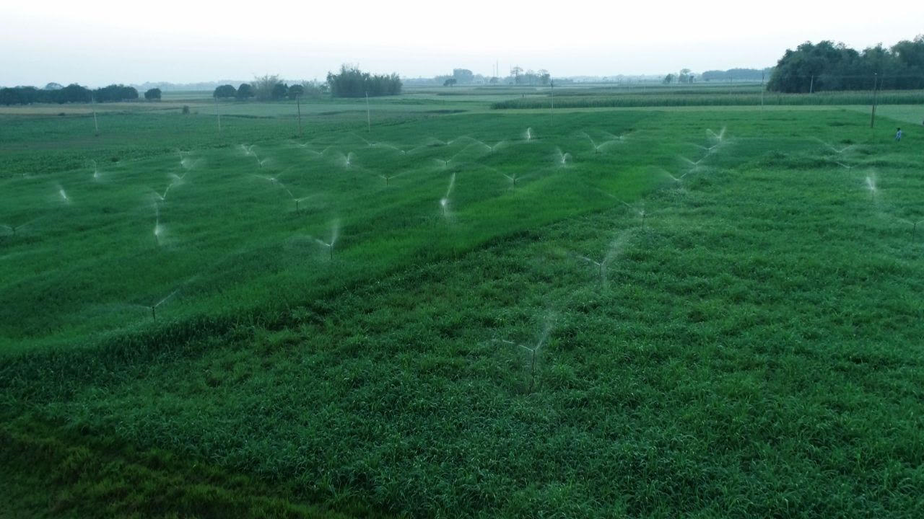


कृषि विभाग
उद्यान निदेशालय
बिहार
“Per Drop-More Crop”
Unleashing the Potential of Micro Irrigation in Bihar
Presentation
Radha Raman
Joint Director, Horticulture, Bihar
26-05-2023

Slide 2




बिहार में सूक्ष्म सिंचाई की दिशा में पहल
Journey of Micro-Irrigation in Bihar
Various Schemes Ongoing in Bihar
2022-23
1
2022-23
Mulching and Individual boring launched
Mega Promotional event Organised
2021-22
Drip, Mini, Micro and Portable Sprinkler
Portable Sprinkler and Trenching Launched
2020-21
Installation of Community Borewell began
Initiative Towards
Smart Agriculture in Bihar
2
4
2019-20
Indi.
Borewell
Community
Borewell
2015-16
Online application system started
Pradhan Mantri Krishi Sinchayee Yojana (PMKSY) Launched
Trenching
3

Slide 3
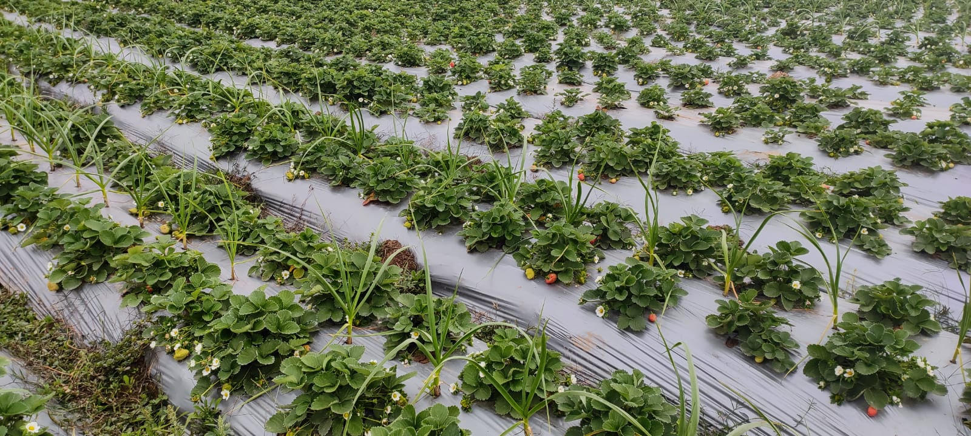
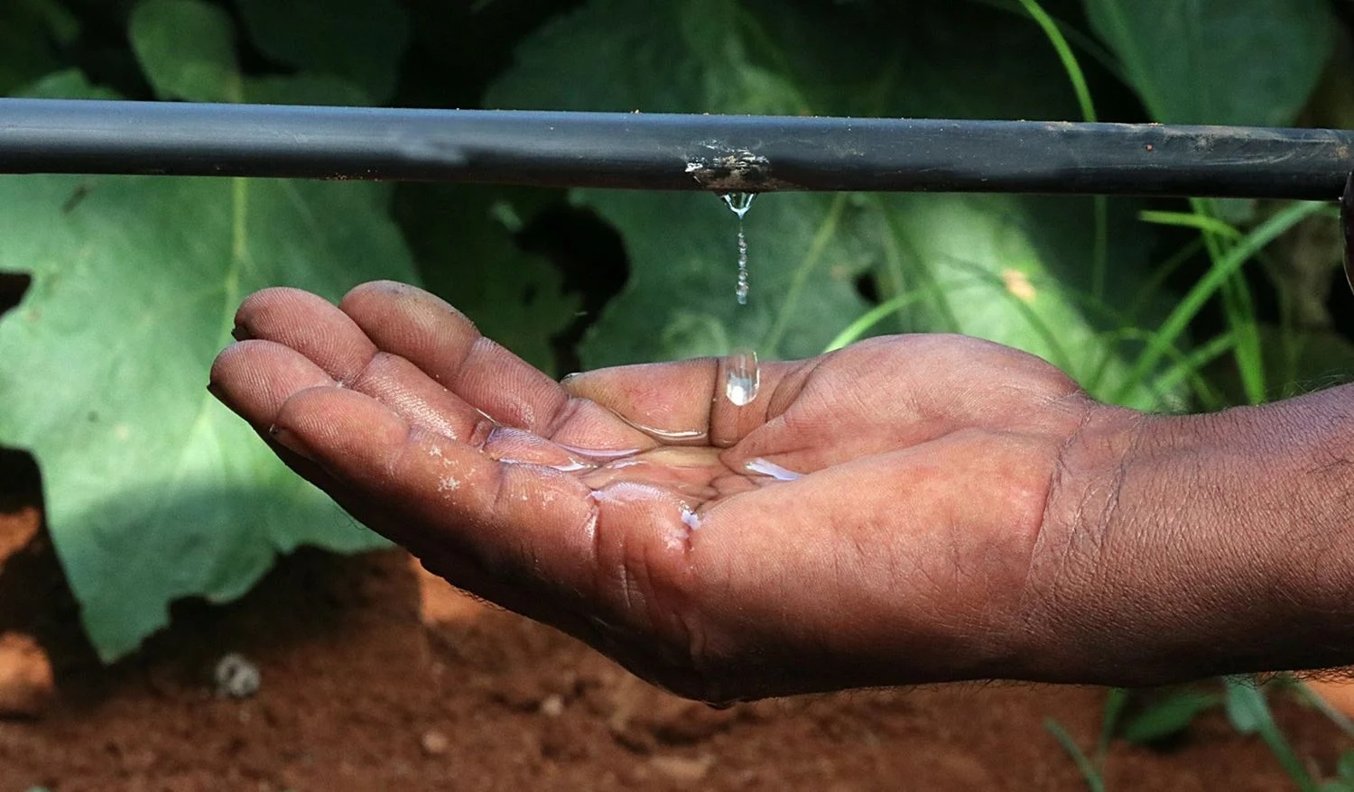
बिहार सरकार द्वारा विशेष वित्तीय सहायता
Drip, Mini and Micro Sprinkler
Category of Farmers’ | Central Share (%) | State Share (%) | Top up (%) | Total State Share (%) | कुल राज्य का अंश (%) | Total Subsidy (%)
Small and Marginal Farmers | 33% | 22% | 35% | 57% |  | 90%
Big Farmers | 27% | 18% | 45% | 63% |  | 90%
Portable Sprinkler
Category of Farmers’ | Central Share (%) | State Share (%) | Top up (%) |  | Total Subsidy (%)
Small and Marginal Farmers | 33% | 22% | - |  | 55%
Big Farmers | 27% | 18% | - |  | 45%

Slide 4
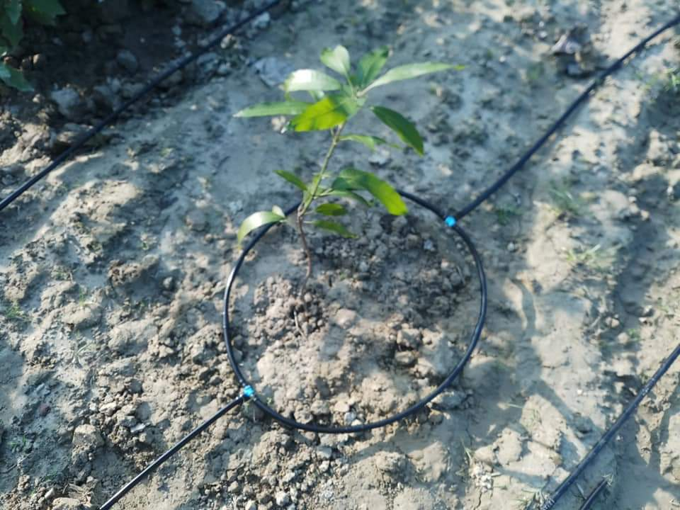

उपलब्धि-
प्रधानमंत्री किसान सिंचाई योजना-
प्रति बूंद अधिक फसल
Achievement of PMKSY Scheme in FY 2022-23 :
Annual Target (Acre): 12,350
Achievement (Acre): 10,048
Achievement %: 81%
State government is envisioned to cover 1 lakh acre area under micro-irrigation by 2024-25.
Cumulative Achievement is approx. 21 Thousand Acre.

Slide 5
ड्रिप, मिनी और माइक्रो स्प्रिंकलर की जिलावार उपलब्धि
Out of 38 districts, 22 districts have achievement more than 50%
There is huge scope for increasing the pace of implementation.

Slide 6
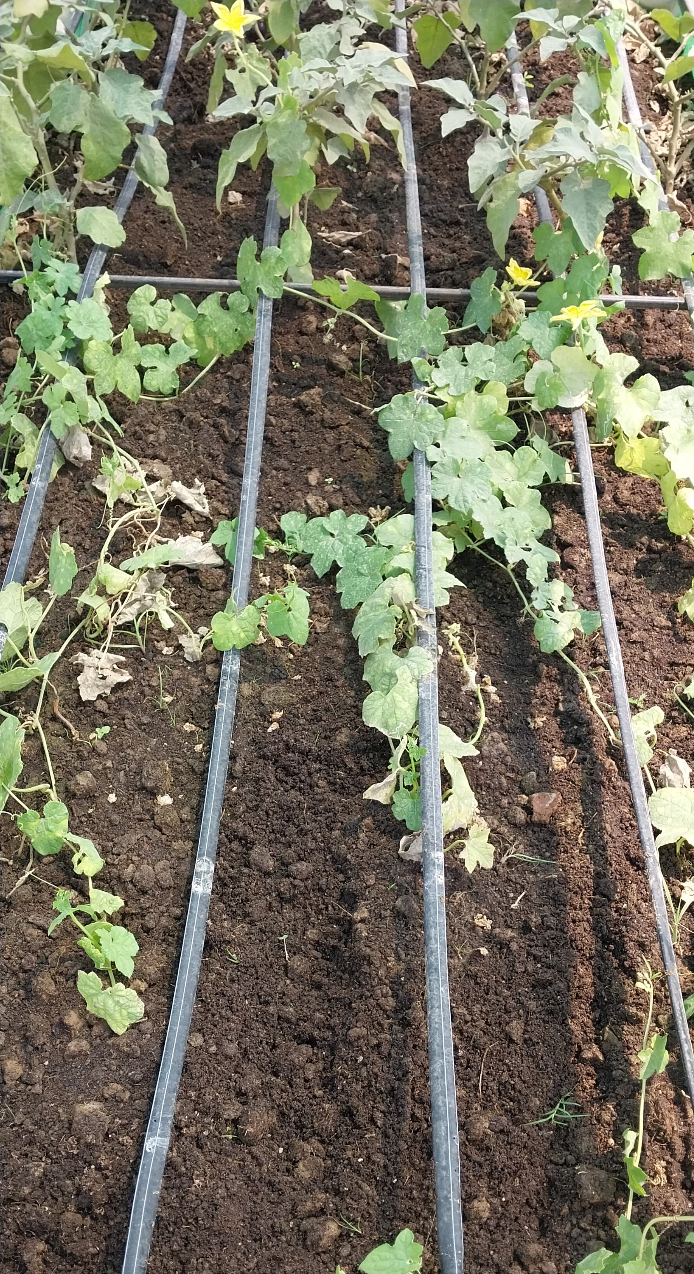
ड्रिप, मिनी और माइक्रो स्प्रिंकलर में माइक्रो इरीगेशन कंपनी की उपलब्धि
There are 30 MI Companies are registered for Installation of Micro-Irrigation machines

Slide 7
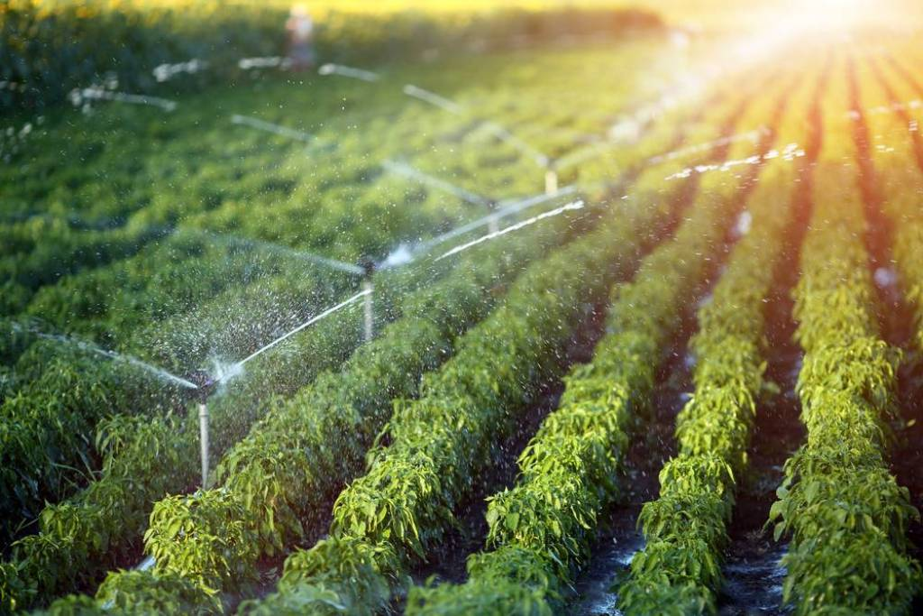
ड्रिप, मिनी और माइक्रो स्प्रिंकलर में माइक्रो इरीगेशन कंपनी की उपलब्धि

Slide 8
सूक्ष्म सिंचाई को बढ़ावा देने हेतु अन्य सहायक योजनाएं
Trenching Scheme
(ट्रेन्चिंग योजना)
100% Subsidy
Individual Borewell Scheme
व्यक्तिगत नलकूप योजना
INR 40 Thousand Subsidy
Community Borewell Scheme
(सामूहिक नलकूप योजना )
80% Subsidy
Community Borewell and Trenching Scheme being implemented under Saat Nischay -2 of Govt. of India
Being implemented under Other Interventions of PMKS

Slide 9
सामूहिक नलकूप योजना की उपलब्धि
व्यक्तिगत नलकूप योजना की उपलब्धि
योजना की शुरुआत वित्तीय वर्ष 2022-23 में हुई
न्यूनतम 0.5 एकड़ रकवा में ड्रिप सिंचाई अपनाने वाले एकल कृषकों के लिए जल स्रोत के सृजन हेतु व्यक्तिगत नलकूप के अधिष्ठापन पर अधिकतम ₹ 40,000 (₹ 25,000 बोरिंग एवं ₹ 15,000 मोटर के लिए) अनुदान का प्रावधान है।
Achievement
  Annual Target of Installation: 3250
  Work Order Issued: 697
  Achievement: Installations are in progress
6.25 एकड़ भूमि पर ड्रिप सिंचाई करने वाले न्यूनतम 5 लघु एवं सीमांत किसानों के समूह को जल स्रोत के सृजन पर 80 % अनुदान पर सामूहिक नलकूप का प्रावधान है.

Slide 10
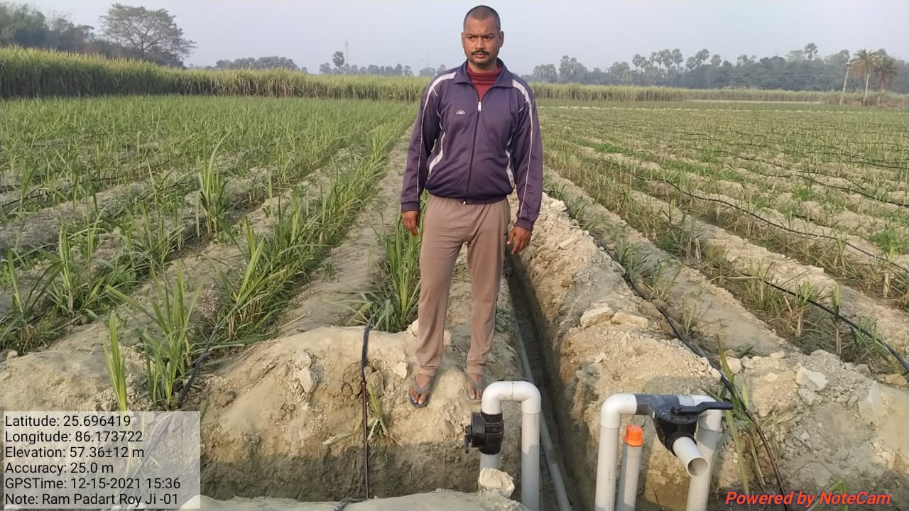
ट्रेन्चिंग योजना की उपलब्धि
ड्रिप सिंचाई यंत्र के अधिष्ठापन हेतु सभी श्रेणी के किसानों के लिए शत प्रतिशत अनुदान पर ट्रेंचिंग ( 80 मि. प्रति एकड़) का प्रावधान हैI

Slide 11







BIHAR – A POTENTIAL STATE FOR MICRO-IRRIGATION
Bihar is a leading state in
production of horticultural produce
1
3
3
4
7
Overall Ranking in Country wrt Production
7
5
Vegetables
8
Litchi
Guava
Potato
Mango
Banana
Fruits
Source: 3rd Advance Estimate 2021-22, Dept. Of Agri. & FW
Producing more than 42% of the total Litchi production in the country.
Producing more than 9 % of the total Guava production in the country
Producing more than 17% of the total Potato production in the country
Producing more than 7% of the total Mango production in the country.
Producing more than 6% of the total Banana production in the country.

Slide 12
BIHAR – A POTENTIAL STATE FOR MICRO-IRRIGATION
From North-west to central Bihar i.e. from West Champaran to Samastipur Sugarcane is major crop (3,14,987 Ha)
Area around Muzaffarpur, Samantipur,Vaishali are cradle of Shahi Litchi (GI tagged) (36,673) with a ambitious target of 300 Ha area expansion every year
Kishanganj is blessed with TEA and Pineapple
Bhagalpur known to produce Jardalu mango, GI tagged, and Mango in whole having acreage of 1,60,237Ha and 1100 Ha under area expansion per year.
Besides above the farmers of Bihar are cultivating Strawberry, Dragon fruit (Kamlam), etc.
Cultivable land under Fruits are 3.6 lakh Ha and vegetable 9.17 lakh Ha which have precise water requirement.

Slide 13




BIHAR – A POTENTIAL STATE FOR MICRO-IRRIGATION
Bihar is a leading state in
production of Grains
Paddy
Area – 2.94 million hectares
Production – 11.48 million tonnes
2021-22 (3905 kg/ha.)
2005-06 (1075 kg/ha.)
Wheat
Area – 2.20 million hectares
Production – 6.36 million tonnes
2021-22 (2886 kg/ha.)
2005-06 (1617 kg/ha.)
Maize
Area – 0.66 million hectares
Production – 3.64 million tonnes
2021-22 (5541 kg/ha.)
2005-06 (2298 kg/ha.)
Source: Department of Agriculture, Govt. of Bihar

Slide 14
Expectation from MI Companies
Bihar has fragmented agriculture landholding (Average agriculture landholding 0.39Ha.) Micro-irrigation companies should customize their service portfolio in view of small landholding of the farmers
MI companies should also focus on post installation service i.e. Repair & Maintenance of the installed machines
MI Company should also focus on awareness generation

Slide 15
We look forward to working together for Agricultural transformation in Bihar !
Thank You!

